Slide 2
Building great libraries using .NET Standard
Aaron Amm Theeranit
Senior Software Engineer

Slide 3
Covers:
What is .NET Standard
How to create .NET Standard class library project
Consume your .NET Standard in your .NET Framework project and .NET Standard project
.NET Standard work under the hood
Type forwarding and netstandard.dll
Not Covers:
Multiple target .NET Standard class library and platform specific
Consume .NET Framework class library and .NET .Core library in your .NET standard library
Package Nuget Package

Slide 4
What is .NET Standard?

Slide 5
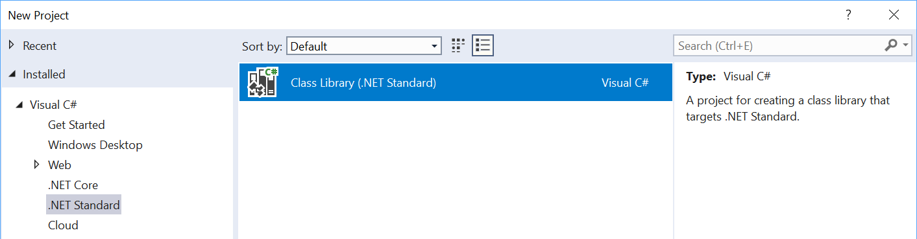
What is .NET Standard?
.NET Standard is a specification
A set of APIs all .NET platforms have to implement
.NET Standard
.NET Core
.NET Framework
Xamarin
~
~
HTML specification (W3C)
Browsers (Chrome, Edge)

Slide 6
.NET Standard in context
.NET FRAMEWORK
.NET CORE
XAMARIN
.NET Standard

Slide 7
What’s in .NET Standard?
Microsoft.Win32.SafeHandles
System
System.CodeDom.Compiler
System.Collections
System.Collections.Concurrent
System.Collections.Generic
System.Collections.ObjectModel
System.Collections.Specialized
System.ComponentModel
System.ComponentModel.Design
System.ComponentModel.Design.Serialization
System.Configuration.Assemblies
System.Data
System.Data.Common
System.Data.SqlTypes
System.Diagnostics
System.Diagnostics.CodeAnalysis
System.Diagnostics.Contracts
System.Diagnostics.SymbolStore
System.Diagnostics.Tracing
System.Drawing
System.Dynamic
System.Globalization
System.IO
System.IO.Compression
System.IO.IsolatedStorage
System.IO.MemoryMappedFiles
System.IO.Pipes
System.Linq
System.Linq.Expressions
System.Net
System.Net.Cache
System.Net.Http
System.Net.Http.Headers
System.Net.Mail
System.Net.Mime
System.Net.NetworkInformation
System.Net.Security
System.Net.Sockets
System.Net.WebSockets
System.Numerics
System.Reflection
System.Reflection.Emit
System.Resources
System.Runtime
System.Runtime.CompilerServices
System.Runtime.ConstrainedExecution
System.Runtime.ExceptionServices
System.Runtime.InteropServices
System.Runtime.InteropServices.ComTypes
System.Runtime.Serialization
System.Runtime.Serialization.Formatters
System.Runtime.Serialization.Formatters.Binary
System.Runtime.Serialization.Json
System.Runtime.Versioning
System.Security
System.Security.Authentication
System.Security.Authentication.ExtendedProtection
System.Security.Claims
System.Security.Cryptography
System.Security.Cryptography.X509Certificates
System.Security.Permissions
System.Security.Principal
System.Text
System.Text.RegularExpressions
System.Threading
System.Threading.Tasks
System.Timers
System.Transactions
System.Windows.Input
System.Xml
System.Xml.Linq
System.Xml.Resolvers
System.Xml.Schema
System.Xml.Serialization
System.Xml.XPath
System.Xml.Xsl
All the foundational APIs
~37k APIs in .NET Standard 2.0

Slide 8
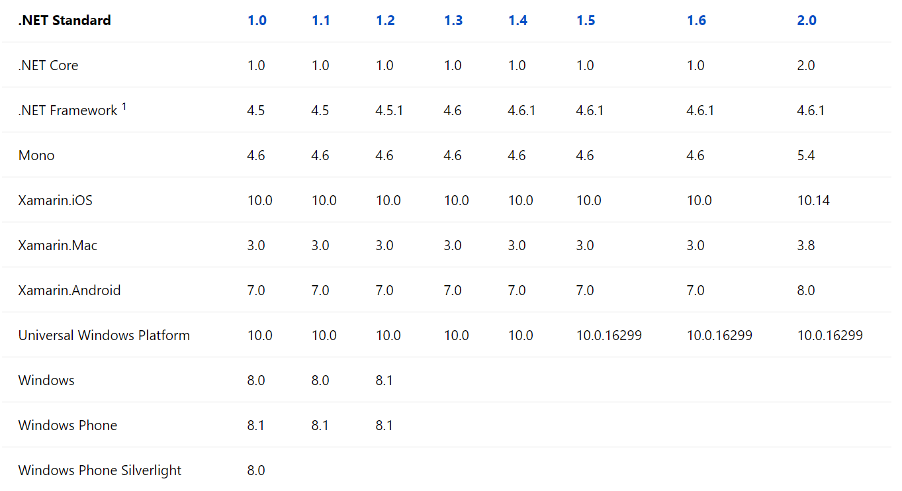
Versions of .NET Standard
Don’t worry about it.
Start with .NET Standard 2.0.

Slide 9
.NET Standard is also Open Source!
Next version is planned here:
https://github.com/dotnet/standard/tree/master/docs/planning/netstandard-2.1

Slide 10
Minimum requirement
Visual Studio 2017
.NET Framework 4.7.2
.NET Core 2.1

Slide 11
Create a .NET Standard project

Slide 12
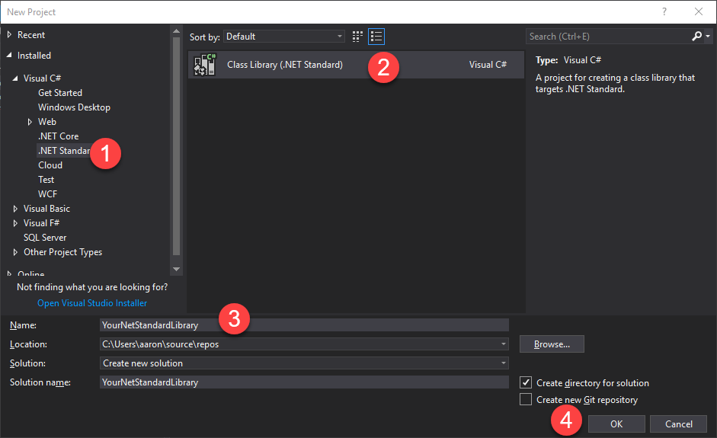

Slide 13
DEMO CodeSanook.VersionNumberToVersionCode

Slide 14
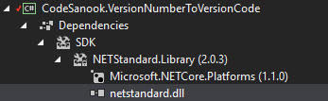
Compile against netstandard.dll
All APIs in netstandard.dll

Slide 15
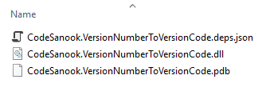
Build output

Slide 16
Use your .NET Standard class library

Slide 17
DEMO Use your .NET Standard library in your .NET Framework

Slide 18
DEMO Use your .NET Standard library in your .NET Framework

Slide 19
Under the hood

Slide 20
.NET Standard under the hood with .NET Framework
YOUR .NET Framework APPLICATION
.NET Framework ASSEMBLIES
TYPE
FORWARDING
YOUR .NET Standard CLASS LIBRARY
NETSTANDARD.DLL
This happens when you load .NET Standard-based library
Notes:
Common language runtime handle type forwarding

Slide 21
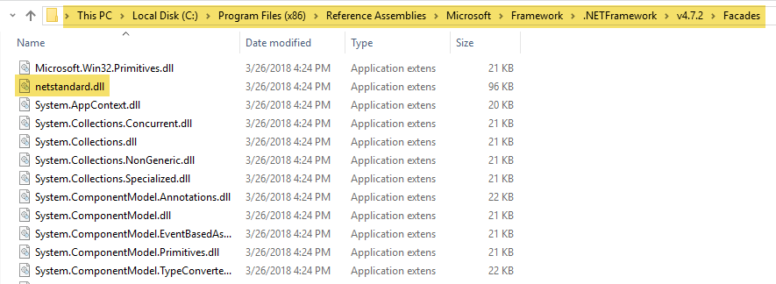
netstandard.dll in .NET Framework
C:\Program Files (x86)\Reference Assemblies\Microsoft\Framework\.NETFramework\v4.7.2\Facades

Slide 22
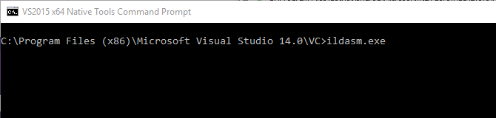
Launch ILDASM tool
C:\Program Files (x86)\Microsoft Visual Studio 14.0\VC>ildasm.exe

Slide 23
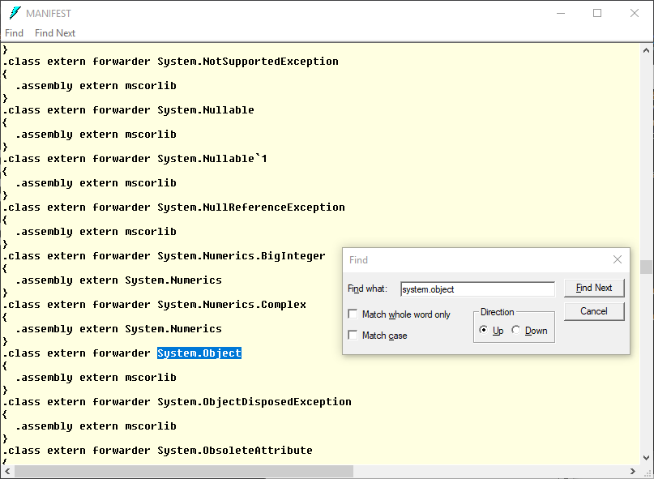

Slide 24
.NET Standard under the hood with .NET Core
YOUR .NET Core APPLICATION
.NET Core ASSEMBLIES
TYPE
FORWARDING
YOUR .NET Standard CLASS LIBRARY
NETSTANDARD.DLL
This happens when you load .NET Standard-based library
Notes:
Common language runtime handle type forwarding

Slide 25
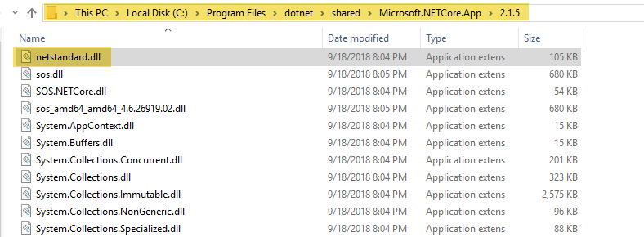
netstandard.dll in .NET Core
C:\Program Files\dotnet\shared\Microsoft.NETCore.App\2.1.5

Slide 26
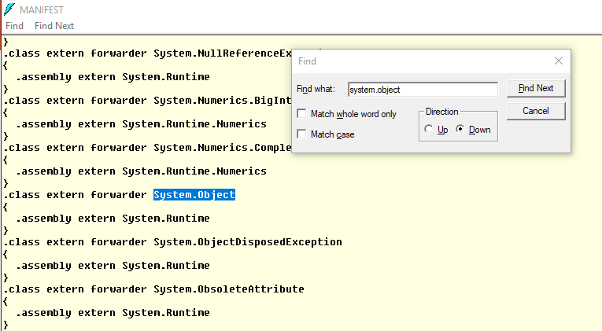

Slide 27

Q & A
http://codesanook.com
https://fb.com/codesanookpage
https://fb.com/groups/codesanook
Aaron Amm Theeranit
theeranitp@gmail.com

Slide 28
Likely questions
How to build documentation?
How to build NuGet packages?
Why would I target .NET Core instead of .NET Standard?
Why is it worth targeting 2.0 if you already target 1.x?
Will .NET Standard 2.1 be supported on .NET Core 2.1+?
Will .NET Standard 2.1 be supported on .NET Framework?
Why is cross-referencing problematic and when should you use it?
What are the differences between package version, assembly version, assembly file version and product version? When should I increment what?

